Slide 1
Welcome To the Nursing Program Information Session
Geri Brewer RN MSN –Nursing Department Chairperson

Slide 2
A note from the chair…
Welcome from a former
triton grad herself!
Nursing as a profession-most trusted
Commitment is worth it
full-time job with benefits
Many opportunities in the profession
very fulfilling to help and heal people
Must be flexible with work life
Triton’s nursing program offers many resources

Slide 3
Nursing Education
Earn AAS Degree at Triton College (Associate of Applied Science degree)
Become a licensed RN
Complete a BSN with one of our University Partners

Slide 4
Residency
Tuition
In District Communities
•NUR course tuition -34 NUR credits & 26 NON-NUR credits
•In-district- $195.00 per credit hour
• Out-of-district - $360.00 per credit hour
•Non -NUR courses In-district - $123 per credit hour
Out-of-district - $320.53 per credit hour
Tuition and fees subject to change at any time
Bellwood
Berkeley
Broadview
Brookfield (part)
Elmwood Park
Franklin Park
Forest Park
Harwood Heights (part)
Hillside
Hines
LaGrange Park (part)
Maywood
Melrose Park
Norridge (part)
Northlake
North Riverside

Slide 5
Nursing Admission Process
Complete a Triton College Application
Take the placement exam for Math, Reading and Writing
Complete a nursing application via http://www.triton.edu/healthappnursing/
Submit official transcripts from High school graduation or GED
Attendance at a Nursing Information Session is highly recommended
Completion of a nursing pre-admission test (TEAS-Test of Essential Academic Skills)
All test scores must be within the last two years
Applicants should not apply to the Nursing program until they have successfully completed the
prerequisites and preadmission courses for the program;
Admission is determined by a point system based on a nursing pre-entrance test, Grade Point Average for
college level preadmission courses (RHT 101, PSY 100, and BIS 241) and previous college academic
history.
Placement Exam
Once admitted to the college, college placement exams in Math

Slide 6
Placement Exam Once admitted to the college, college placement exams in Math, Reading and Writing are to be taken.
if a student has college credit for English and/or Math, placement tests, they do not have to be completed.
if a student has taken math more then 5 years ago, the student is required to take the test to place out of the math course or the student can take MAT 085 or MAT 170 without taking the test.
If a student has never taken English and/or Math, the student is required to take the placement tests.

Slide 7
Placement Exam Take College Placement tests: ACCUPLACER Math, Reading & Writing Room A 126, no appointment needed
Testing hours (fall & spring) Mon-Thurs 8:30am-6pm, Fri 8:30am-2pm, Sat 9:30am-12pm
Testing hours (summer) Mon-Thurs 8:30am-6pm, Fri 8:30am-12pm, Sat 9:30am-11am
Must receive required score to place into
MAT 085 or higher (EA 61-120 or QAS 237-300)
Must Receive required score to place into
RHT 101
(Reading 80-120 or NG Reading & Writing Composite 550-600)

Slide 8
Teas Exam
This is the nursing preadmission exam. Triton College Testing Center is currently administering Version :V form - A of the TEAS Exam.
The TEAS Exam consists of four parts:
Reading (58 min/48 questions)
Math (51 min/34 questions)
Science (66 min/54 questions)
English/Language Usage (34 min/34 questions)
Students must obtain the following overall scores to qualify:
• 90.7 % = 4pts towards admission
• 78.0 % = 3pts towards admission
• 58.7 % = 2pts towards admission

Slide 9
TEAS EXAM
Applicants for admission taking the TEAS at Triton Colleges' Testing Center must:
Set up a student account at www.atitesting.com. You must register online before you can take the test.
Schedule a test date and pay the test fee online. Applicants will not be permitted to register on the day of the examination.
Information about the testing center can be found via https://www.triton.edu/students/testing-center/
Arrive at the Testing Center with receipt and proper ID (valid government-issued photo ID with a signature) on the scheduled testing date. Students reporting without proper ID will be turned away and will be responsible for repaying and rescheduling for a new test. No admission will be allowed once the testing begins

Slide 10
Teas scores and retesting
Examinees will receive immediate test results at the end of their testing session.
Examinees are eligible to test three times within a two-year period.
There is a 30-day wait period between retakes.
Triton College accepts passing TEAS scores from other colleges; test scores are valid for two years and must be valid on the date the application is submitted.
Students may request a transcript of their scores from ATI at
http://www.atitesting.com Any scores submitted will count as an attempt.
Remediation information is attached to the information session packet. All are encouraged no matter what your composite score is to take time to review the remediation materials

Slide 11
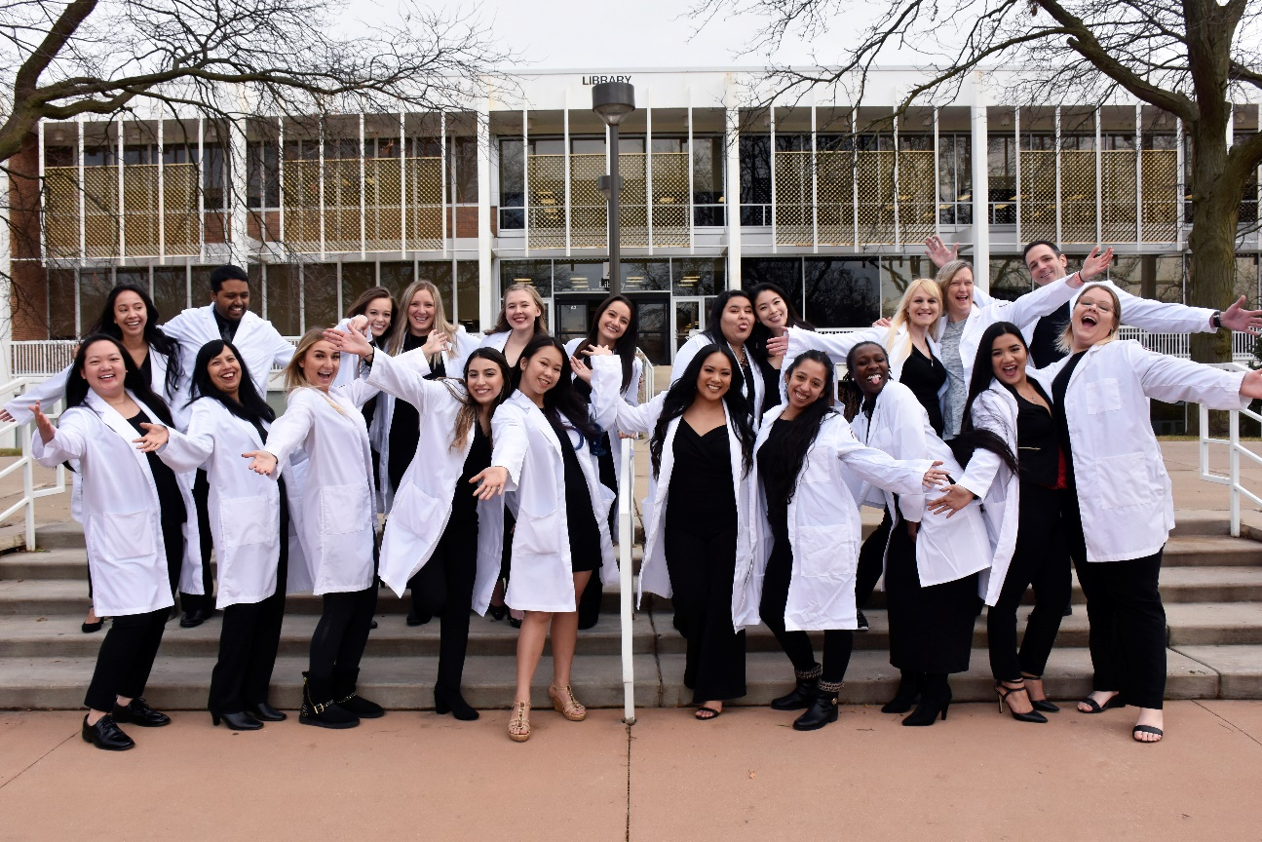
You can do this!!!

Slide 12
Pre-requisites
All required math and science courses will be considered only if completed within the last 5 years of entry into the nursing program.
Math and science courses require a grade of “C” or better.
Students must complete all pre-requisites and pre-admission courses before seeking admission into the program.
All pre-requisite courses must be completed with a grade of “C” or better.

Slide 13
Changes in Spring 2022
All nursing applicants
will be required to have a
CNA certificate

Slide 14
General Education Courses General education courses are required to receive AAS degree. It is helpful to complete these courses prior to the start if nursing courses.
EDU 206◊ Human Growth and Development 3 credits
BIS 222◊ Principles of Microbiology 4 credits
SOC 100◊ Introduction to Sociology 3 credits
RHT 102◊ Freshman Rhetoric and Composition II 3 credits
SPE 101◊ Principles of Effective Speaking 3 credits
Total 16 Gen ED credit hours

Slide 15
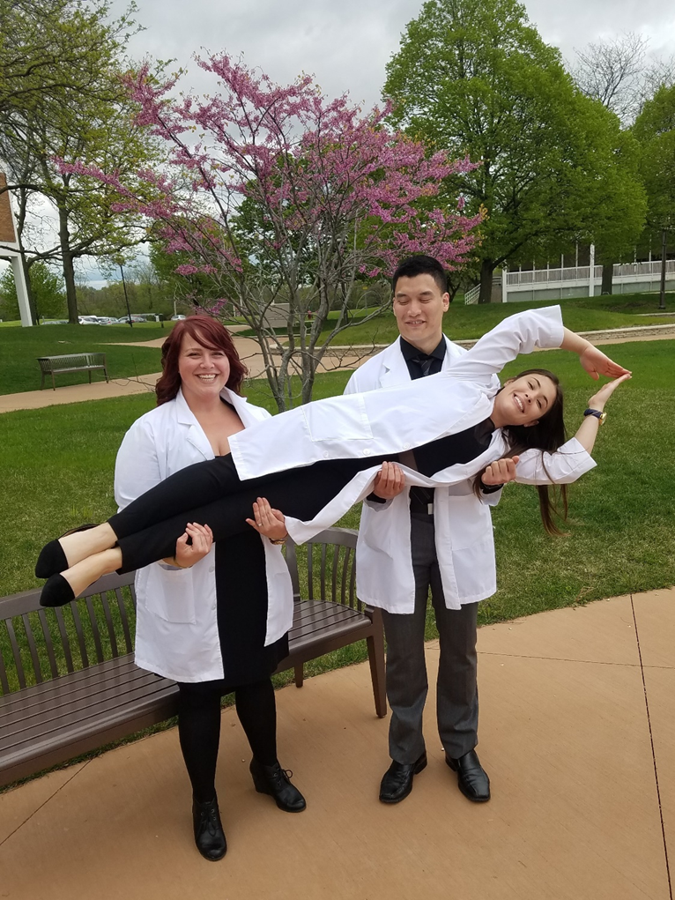
Additional points…
Previously College Academic History
No D or F = 0.5 pts
No more than 1 semester “W” = 0.5 pts
Previously earned Associate Degree = 0.5 pts
Previously earned Bachelors Degree = 1.0 pts
(Awarded either Associate Degree or Bachelors Degree cannot earn points for both degrees
You Got This!

Slide 16
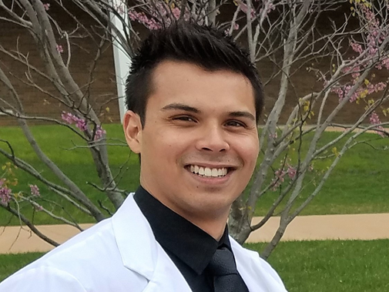
In a nutshell….
Aim for high scores

Slide 17
Other Program Requirements
CPR
Health requirements
Criminal background check – CLEAR, no misdemeanors or felonies
• Start expunging or pardon procedure NOW Reference – http://www.isp.state.il.us/
Drug screening-sorry no marijuana in the system
Alcohol breath test
Annual flu shots
Students are responsible for the cost of the above requirements

Slide 18
“Some people
want
it to happen, some wish
it would happen, others make
it happen.”
- Michael Jordan
Make this happen!!

Slide 19
Student Resources
Financial Aid Office: B 160, ext 3155
Federal & State
Grants, awards & work study
Local & private scholarships
Student Loans
Institutional awards
Veteran’s Office Programs B 160, ext 3651 OR 3531
Triton Retraining Assistance Center (TRAC) A-204 ext 3149
Chargeback programs: Comprehensive Agreement Regarding the Expansion of educational Resources (CAREER B 220, ext 3726)

Slide 20
Changes in Spring 2022
All nursing applicants
will be required to have a
CNA certificate

Slide 21
Contact Information
Kayla Gagliardi kaylagagliardi@triton.edu Advisor
Sandra werner sandrawerner@triton.edu advisor
Alesia ivy ALESIAIVY@TRITON.EDU ADVISOR
Tiffany Irby -Health Careers Information Specialist
H133 708-456-0300 ext. 3982
tiffanyirby@triton.edu
Tatiana Ross-King- Nursing Secretary
H200 708-456-0300 ext. 3776
tatianaross@triton.edu
Sandra Bowling-CNA Coordinator
H-200 708-456-0300 EXT. 3767
SANDRABOWLING@TRITON.EDU
Geri Brewer -Chair of Nursing program
H 203 708-456-0300 ext. 3900
geribrewer@triton.edu

Slide 22
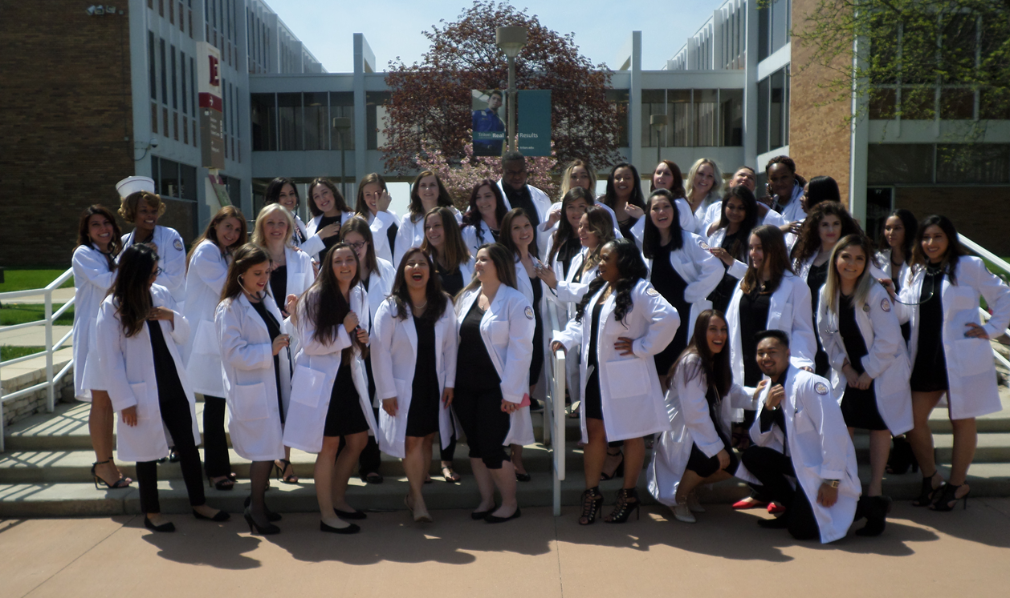
We’ll be seeing you soon!

