Slide 1


Why Accept Membership
Notes:
Welcome to this information session about Phi Theta Kappa.
First – we want to congratulate you on your superior academic achievements which have awarded you an invitation to Phi Theta Kappa Honor Society.
PTK believes in you and in your potential. We are dedicated to empowering you to take control of your destiny with the resources and support Phi Theta Kappa offers to its members. Let’s delve deeper…

Slide 2
Our Mission
The mission of Phi Theta Kappa is to
recognize academic achievement of college students and to provide opportunities for them to grow as scholars and leaders.
Notes:
Our mission at Phi Theta Kappa Honor Society is to recognize your academic achievements, but that’s just the beginning. We also have programs and resources to provide opportunities for our members to grow as scholars and leaders. PTK’s mission has essentially remained the same since we were founded in 1918, and that is to serve and support college students to ensure their future success.

Slide 3
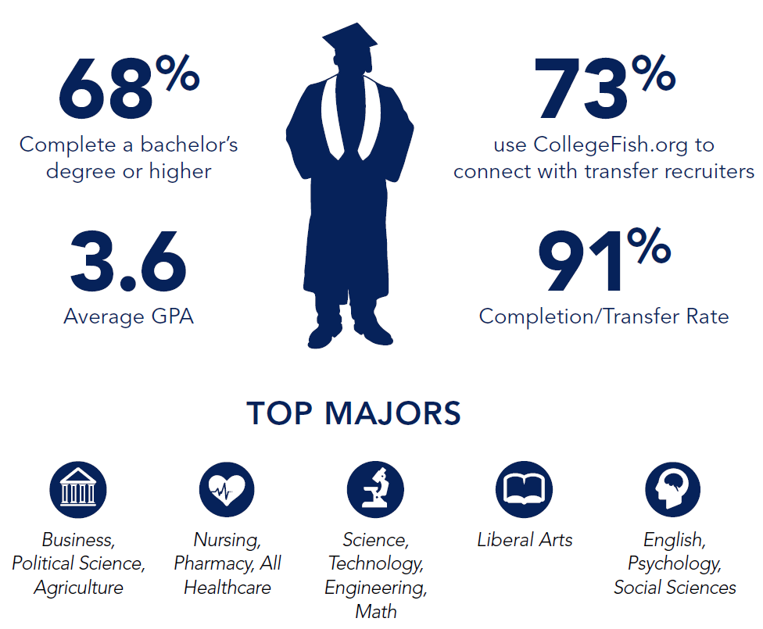
Who is Phi Theta Kappa?
Notes:
If have received an invitation to join Phi Theta Kappa, you may be wondering who our members are. Phi Theta Kappans represent a diverse group of students from an array of majors. As you’ll see in this snapshot, 68 percent of our members complete a Bachelor’s Degree or higher. You’ll, also, see that Phi Theta Kappans have a 91 percent completion or transfer rate. This means that 91 percent of our members either graduate from their current college or transfer to a four-year university.
This snapshot also points to a very high GPA among Phi Theta Kappa members: The average GPA of a PTK member is a 3.6. This high GPA is indicative of the high caliber of students who join PTK. They are hardworking and high-achieving.
You’ll, also, see here that 73 percent of our members use CollegeFish.org to connect with recruiters from four-year universities. CollegeFish.org is an online tool specifically designed to help community college students plan their transfer to a four-year school.
Finally, it is important to note that Phi Theta Kappa is not major specific. We serve all majors, from business to nursing to liberal arts and social sciences.

Slide 4

Where is Phi Theta Kappa?
Notes:
Now that you know a little bit about who we are, let’s cover where Phi Theta Kappa is. We are an international honor society, and we have approximately 1,300 chapters that span 50 states and 9 nations. You’ll see here that Phi Theta Kappa chapters belong to four divisions – each division houses chapters in that specific geographic area.

Slide 5

Common Reasons for Not Accepting Membership
“I have little/no time.”
“I’m a tech student so I’m not
transferring.”
“I am about to transfer.”
“I’ve never heard of PTK.”
“I cannot afford it.”
Notes:
Often, we hear from prospective members who will provide one or more of these common reasons for not accepting membership in PTK. It’s important to debunk some of the myths surrounding membership.
To those prospective members who say they have little or no time to devote to PTK, the answer is simple. There are NO time or involvement stipulations to become or maintain your membership. We understand the reality of work, school, and family obligations, which is why your time investment in Phi Theta Kappa is entirely at your discretion. Of course, you have the opportunity to maximize the benefits of membership by becoming engaged in PTK programs and events.
For those who are in career/technical programs who think PTK will not be beneficial, we have membership benefits that provide you with workplace and leadership skills training that can help you be more competitive in your career. If you are about to transfer, don’t risk losing scholarship money that may be available at your four-year college to PTK members. In addition - Phi Theta Kappa comprises a network of more than 3 million members and alumni – our reach is incredible. Simply listing PTK membership on your resume or job application is impressive.
Finally, we know some prospective members struggle with the membership fee. Please note this is a one-time, lifetime membership fee. PTK is working hard to provide more and more membership fee scholarships to those in need. Be sure to check with your advisor to determine if there are local scholarships or funding set aside to help cover membership. (Share if your chapter/college has a membership fee assistance program that will help students with this cost. PTK Headquarters offers a membership fee waiver called the Golden Opportunity Scholarship that covers the international membership fee portion of the of the membership fee. Students in financial need may be nominated by their local chapter advisor for this waiver.)

Slide 6
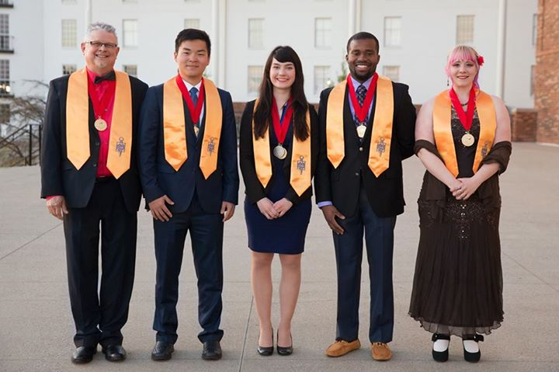
Phi Theta Kappa Structure
INTERNATIONAL LEVEL
International Officers | Phi Theta Kappa Staff
Board of Directors
REGIONAL LEVEL
Regional Coordinator | Regional Officers
Regional Advisory Board
LOCAL LEVEL
Chapter Advisors | Chapter Officers
Chapter Members | Alumni
2017 – 18 International Officer Team
Notes:
Let’s move on to the structure of Phi Theta Kappa. We have three levels. At the international level, we have our international officers (pictured here, our PTK staff, and our Board of Directors. International office is the highest leadership position for current members. There are 5 international office positions: a president and four Divisional Vice Presidents.
At the regional level, there is a regional coordinator who is also a chapter advisor, members who are elected to serve as Regional Officers, and an advisory board made up of chapter advisors.
At the local level, we have chapter advisors and chapter officers, members. Your Phi Theta Kappa membership continues as an alum as soon as you graduate or transfer from your current college.

Slide 7

PTK Helps You Achieve More!
Competitive Edge Career Skills Course
CollegeFish.org
Chapter Projects
Networking & Service Events
Officer and other leadership positions
Notes:
Now let’s talk about ways in which our members can engage in the Society. Keep in mind that engagement in activities at your chapter, in your region, or at the international level is completely voluntary. Of course, membership is what you make of it, and the return on your investment is up to you.
Here, you’ll see some of the opportunities to get involved as a PTK member. Participate in your local chapter’s meetings and events. Complete Competitive Edge, which is our online course focused on strengthening your workplace and career planning skills. If you’re interested in transferring to a four-year school, fill out your CollegeFish.org profile to get matched with transfer opportunities that meet your preferences. Think about running for office. A chapter officer position, for example, is a great way to develop your leadership skills. But remember – you don’t need a leadership title to be a leader.

Slide 8

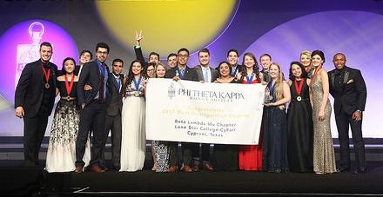
Additional Benefits
Scholarships
  Access to more than $90 Million in scholarships, including $37 Million in transfer scholarships from 750 four-year schools
Regional and International Events
  PTK International Convention
  Honors Institute
  Regional Conferences
  Officer Training
Letters of Recommendation
Corporate Partners Special Offers
Notes:
Here, you’ll see additional benefits of membership. We offer, for instance, ample scholarship opportunities for PTK members. As a Phi Theta Kappan, you’ll have access to more than $90 million in scholarships. That number includes $37 million in scholarships from more than 750 four-year schools that offer transfer scholarships exclusively to PTK members.
As a member, you’ll, also, have access to PTK regional and international events. Each of our 29 regions hosts regional conferences throughout the year, where members can learn about leadership, network with members from nearby chapters, and learn how to implement Phi Theta Kappa chapter programs. Members may also participate in PTK international events such as our annual convention, called PTK Catalyst, and our Honors Institute, which is an intense, one-week conference where members convene at a four-year campus and engage in small group discussions, leadership skills development, and critical thinking focused on our Honors Study Topic.
Additionally, Phi Theta Kappa has strategic corporate partnerships that provide discounts on services for our members while they are in college and beyond. In the same vein, we provide letters of recommendation for our members. If you have a potential employer or four-year university admissions rep who has requested a letter of recommendation, you can easily request this letter from PTK HQ.

Slide 9

Accept Your Membership www.ptk.org/join
Membership Services
help@ptk.org
ptk.org/contact
(800) 946-9995
Notes:
Your chapter leaders will provide instructions on how students accept the membership invitation. If you received an emailed invitation with a passcode, you may accept membership online.
We also welcome any questions you may have at this time.

Slide 10

Celebrating New Members
Induction Ceremony
  Date
  Time
  Location
  Guests
Notes:
For those who accept membership, we don’t want you to miss the opportunity to participate in our chapter’s next induction ceremony.
Here are the details:
The Induction Ceremony publicly recognizes the academic achievement of members. Our Induction Ceremony will be
Date: ____________________
Time: ____________________
Location: _________________
Members may invite family and friends to the Induction Ceremony to join in this special celebration.

Slide 11

Thank You
ptk.org
Notes:
We appreciate your time and investment in learning more about Phi Theta Kappa membership.
Since 1918, PTK has been recognizing and empowering high-achieving college students just like you. This is your time, your opportunity to be recognized for what you have accomplished.
We hope that you will accept the invitation to join the ranks of “Phi Theta Kappa Scholars.”

